Slide 1
The graphical system

Slide 2
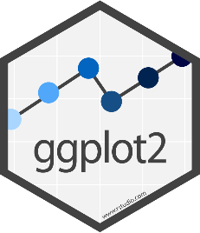
Plotting figures and graphs with ggplot
ggplot is the plotting library for tidyverse
Powerful
Flexible
Follows the same conventions as the rest of tidyverse
Data stored in tibbles
Data is arranged in 'tidy' format
Tibble is the first argument to each function

Slide 3
Introduction to ggplot2
We will be creating plots using the ggplot2 package.
> library(dplyr)
> library(ggplot2)
There are also other packages for creating graphics such as grid and lattice. We chose to use ggplot2 in this book because it breaks plots into components in a way that permits beginners to create relatively complex and aesthetically pleasing plots using syntax that is intuitive and comparatively easy to remember.
Advantages of ggplot2:
Grammar of graphics
Default behaviour
ggplot2 sheet cheat
Disadvantages of ggplot2:
One limitation is that ggplot2 is designed to work exclusively with data tables in tidy format (where rows are observations and columns are variables).
Notes:
Exploratory data visualization is perhaps the greatest strength of R. One can quickly go from idea to data to plot with a unique balance of flexibility and ease. For example, Excel may be easier than R for some plots, but it is nowhere near as flexible. D3.js may be more flexible and powerful than R, but it takes much longer to generate a plot.
grammar of graphics, the ggin ggplot2. This is analogous to the way learning grammar can help a beginner construct hundreds of different sentences by learning just a handful of verbs, nouns and adjectives without having to memorize each specific sentence.
its default behavior is carefully chosen to satisfy the great majority of cases and is visually pleasing. As a result, it is possible to create informative and elegant graphs with relatively simple and readable code.

Slide 4
Code structure of a ggplot graph
Start with a call to ggplot()
Pass the tibble of data (normally via a pipe)
Say which columns you want to use via a call to aes()
Say which graphical representation (geometry) you want to use
Points, lines, barplots etc
Customise labels, colours annotations etc.

Slide 5
Geometries and Aesthetics
Geometries are types of plot
geom_point() Point geometry, (x/y plots, stripcharts etc)
geom_line() Line graphs
geom_boxplot() Box plots
geom_col() Barplots
geom_histogram() Histogram plots
Aesthetics are graphical parameters which can be adjusted in a given geometry

Slide 6
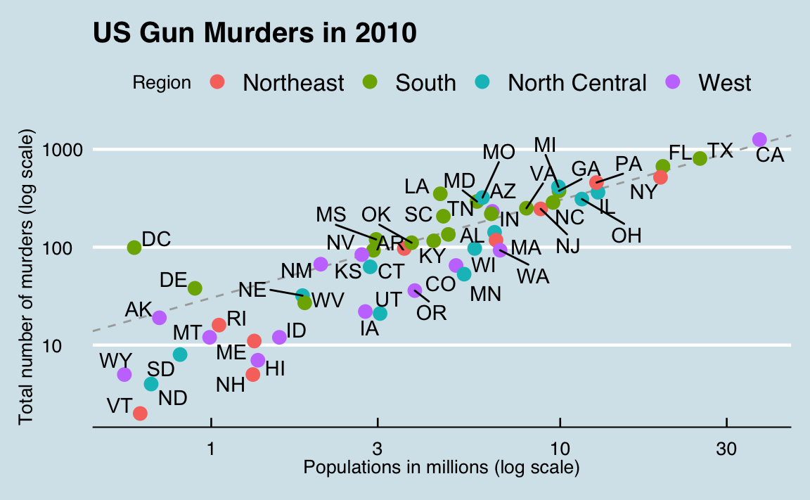
The components of a graph
We will construct a graph that summarizes the US murders dataset that looks like this:
The main three components to note are:
Data: The US murders data table is being summarized.
Geometry: The plot above is a scatterplot. This is referred to as the geometry component.
Aesthetic mapping: The plot uses several visual cues to represent the information provided by the dataset.
Notes:
Other possible geometries are barplot, histogram, smooth densities, qqplot, and boxplot. We will learn more about these in the Data Visualization part of the book.
The two most important cues in this plot are the point positions on the x-axis and y-axis, which represent population size and the total number of murders respectively. Each point represents a different observation, and we map data about these observations to visual cues like x- and y-scale. Color is another visual cue that we map to region. We refer to this as the aesthetic mappingcomponent. How we define the mapping depends on what geometry we are using.

Slide 7

ggplot objects
> ggplot(data = murders) or > murders %>% ggplot() or > p <- ggplot(data = murders)
no geometry has been defined!

Slide 8
Geometries
In ggplot2 we create graphs by adding layers. Layers can define geometries, compute summary statistics, define what scales to use, or even change styles. To add layers, we use the the symbol +. In general, a line of code will look like this:
DATA %>% ggplot() + LAYER 1 + LAYER 2 + … + LAYER N
Geometry function names follow the pattern: geom_X where X is the name of the geometry. Some examples include geom_point, geom_bar and geom_histogram.
> Aesthetics
>
> geom_point understands the following aesthetics (required aesthetics are in bold):
> x
> y
> alpha
> colour

Slide 9
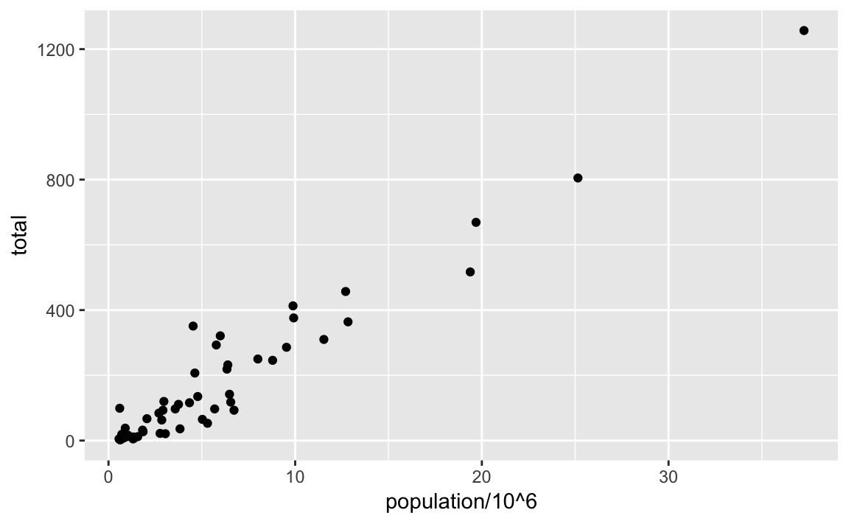
Aesthetic mappings
Aesthetic mappings describe how properties of the data connect with features of the graph, such as distance along an axis, size or color.
murders %>% ggplot() + geom_point(aes(x = population/10^6, y = total))
Or
p + geom_point(aes(population/10^6, total))

Slide 10
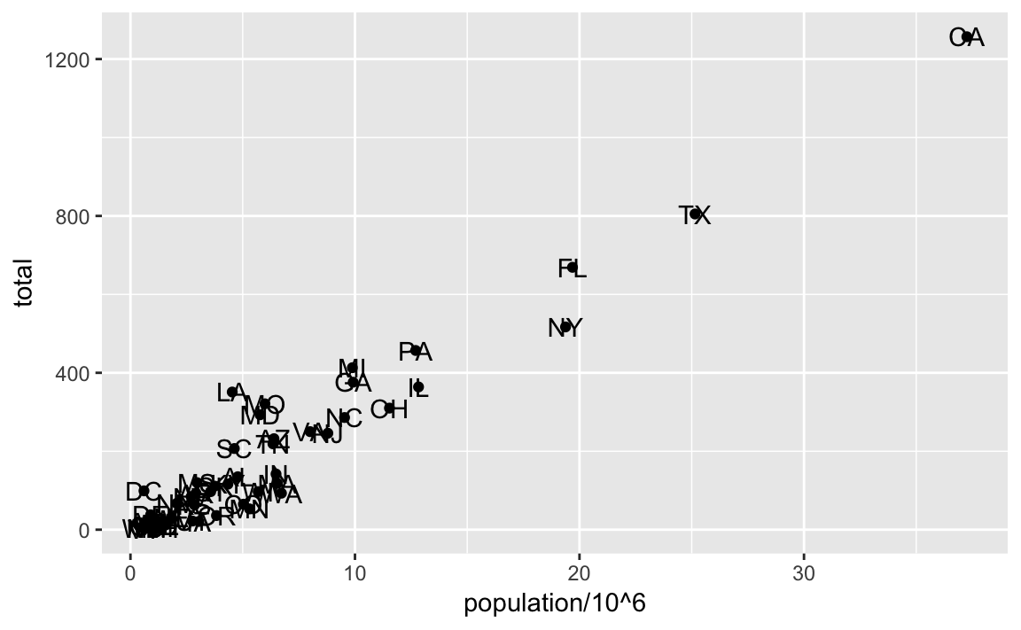
Layers
A second layer in the plot we wish to make involves adding a label to each point to identify the state. The geom_label and geom_text functions permit us to add text to the plot with and without a rectangle behind the text respectively.
p + geom_point(aes(population/10^6, total)) + geom_text(aes(population/10^6, total, label = abb))

Slide 11
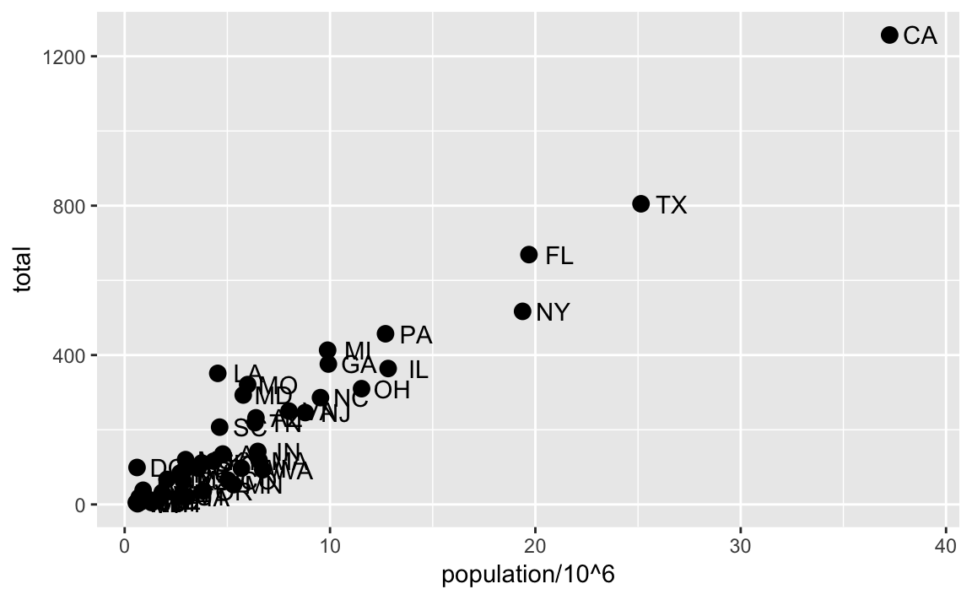
Layers
A second layer in the plot we wish to make involves adding a label to each point to identify the state. The geom_label and geom_text functions permit us to add text to the plot with and without a rectangle behind the text respectively.
p + geom_point(aes(population/10^6, total)) + geom_text(aes(population/10^6, total, label = abb))
p + geom_point(aes(population/10^6, total), size = 3) + geom_text(aes(population/10^6, total, label = abb), nudge_x = 1.5)

Slide 12
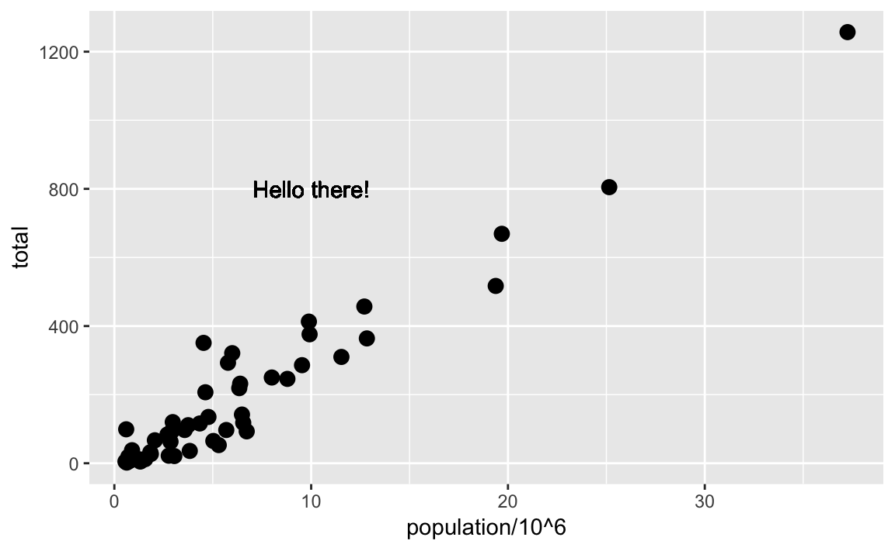
Global versus local aesthetic mappings
p + geom_point(aes(population/10^6, total), size = 3) + geom_text(aes(population/10^6, total, label = abb), nudge_x = 1.5)
Or
p <- murders %>% ggplot(aes(population/10^6, total, label = abb))
p + geom_point(size = 3) + geom_text(nudge_x = 1.5)
If necessary, we can override the global mapping by defining a new mapping within each layer. These local definitions override the global. Here is an example:
p + geom_point(size = 3) + geom_text(aes(x = 10, y = 800, label = "Hello there!"))

Slide 13
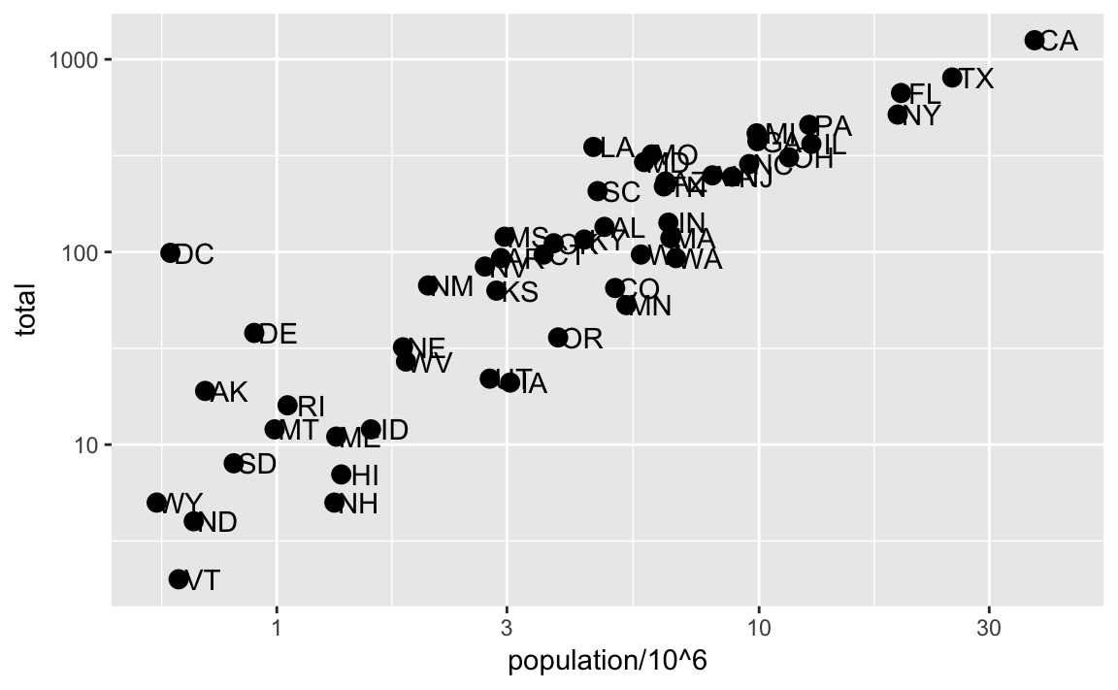
Scales
p + geom_point(size = 3) + geom_text(nudge_x = 0.05) + scale_x_continuous(trans = "log10") + scale_y_continuous(trans = "log10")
p + geom_point(size = 3) + geom_text(nudge_x = 0.05) + scale_x_log10() + scale_y_log10()

Slide 14
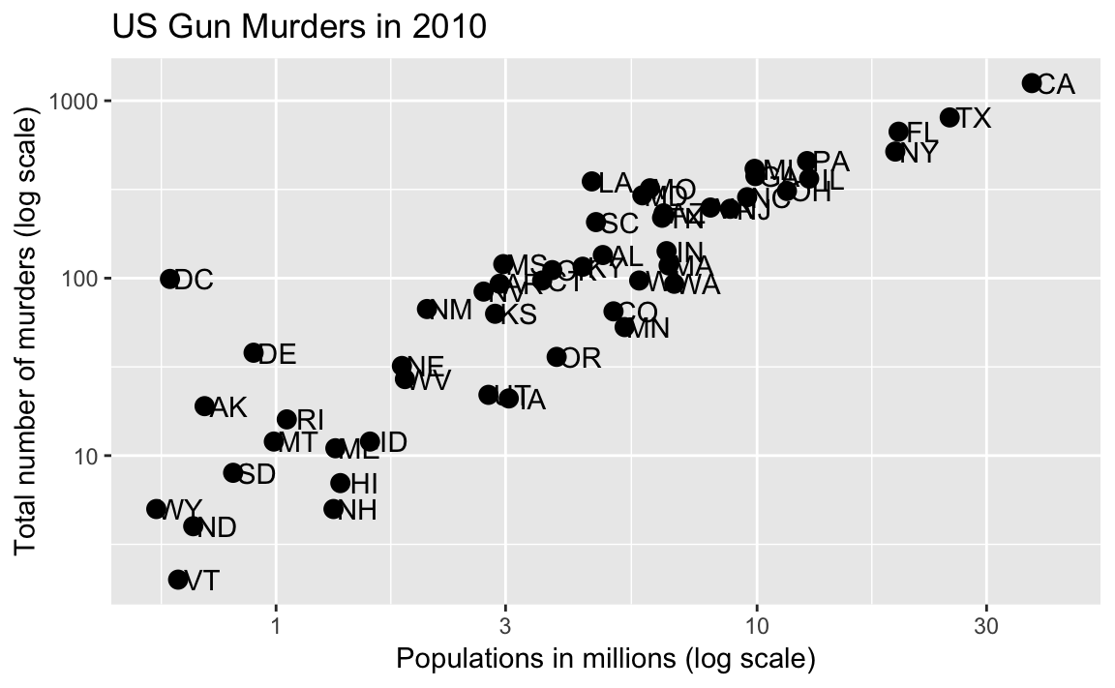
Labels and titles
p + geom_point(size = 3) + geom_text(nudge_x = 0.05) + scale_x_log10() + scale_y_log10() + xlab("Populations in millions (log scale)") + ylab("Total number of murders (log scale)") + ggtitle("US Gun Murders in 2010")
We are almost there! All we have left to do is add color, a legend and optional changes to the style.

Slide 15
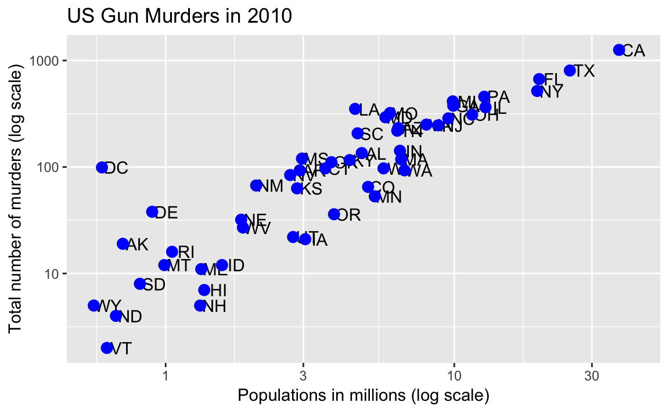
Categories as colors
p <- murders %>% ggplot(aes(population/10^6, total, label = abb)) + geom_text(nudge_x = 0.05) + scale_x_log10() + scale_y_log10() + xlab("Populations in millions (log scale)") + ylab("Total number of murders (log scale)") + ggtitle("US Gun Murders in 2010")
p + geom_point(color ="blue ", size = 3 )
Notes:
We can change the color of the points using the col argument in the geom_point function. To facilitate demonstration of new features, we will redefine p to be everything except the points layer:

Slide 16
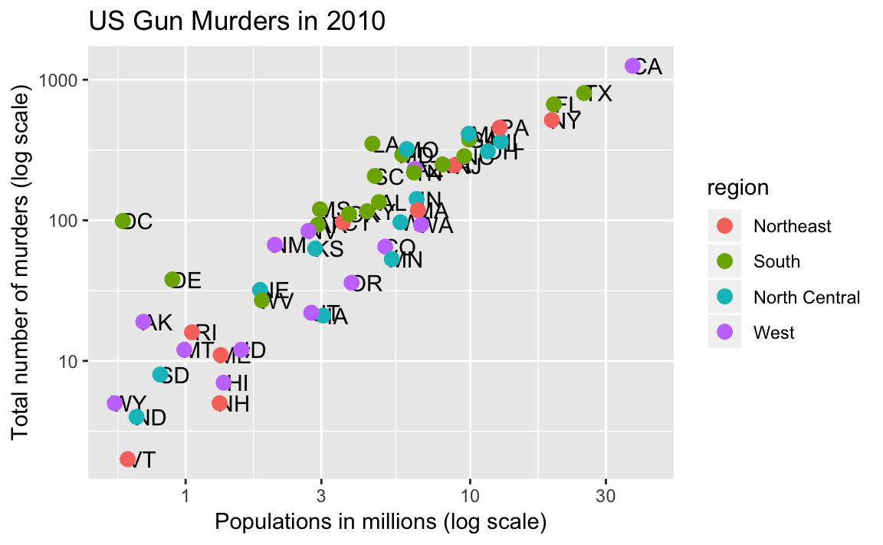
Categories as colors
p <- murders %>% ggplot(aes(population/10^6, total, label = abb)) + geom_text(nudge_x = 0.05) + scale_x_log10() + scale_y_log10() + xlab("Populations in millions (log scale)") + ylab("Total number of murders (log scale)") + ggtitle("US Gun Murders in 2010")
p + geom_point(aes(col=region), size = 3 )
Notes:
We can change the color of the points using the col argument in the geom_point function. To facilitate demonstration of new features, we will redefine p to be everything except the points layer:

Slide 17
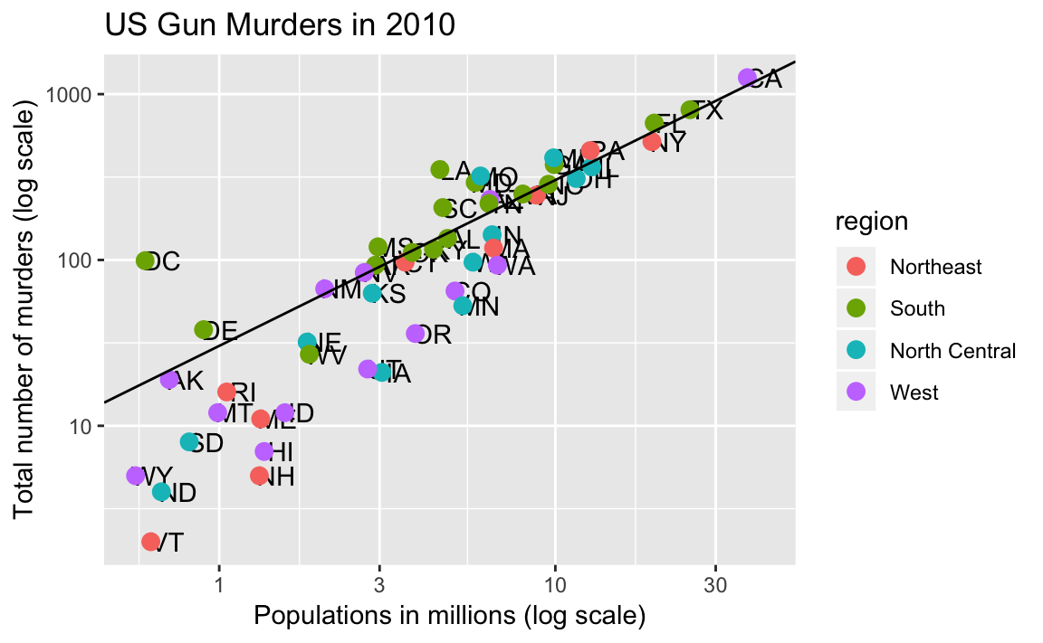
Annotation, shapes, and adjustments
Here we want to add a line that represents the average murder rate for the entire country.
r <- murders %>% summarize(rate = sum(total) / sum(population) * 10^6) %>% pull(rate)
To add a line we use the geom_abline function. ggplot2 uses ab in the name to remind us we are supplying the intercept (a) and slope (b). The default line has slope 1 and intercept 0 so we only have to define the intercept:
p + geom_point(aes(col=region), size = 3) + geom_abline(intercept = log10(r))
Notes:
We often want to add shapes or annotation to figures that are not derived directly from the aesthetic mapping; examples include labels, boxes, shaded areas and lines.

Slide 18
Add-on packages
The power of ggplot2 is augmented further due to the availability of add-on packages. The remaining changes needed to put the finishing touches on our plot require the ggthemes and ggrepel packages.
library(ggthemes)
p + theme_economist()
The add-on package ggrepel includes a geometry that adds labels while ensuring that they don’t fall on top of each other. We simply change geom_text with geom_text_repel.

Slide 19
Putting it all together
Now that we are done testing, we can write one piece of code that produces our desired plot from scratch.

Slide 20
Putting it all together
library(ggthemes)
library(ggrepel)
r <- murders %>% summarize(rate = sum(total) / sum(population) * 10^6) %>%
pull(rate)
murders %>% ggplot(aes(population/10^6, total, label = abb)) +
geom_abline(intercept = log10(r), lty = 2, color = "darkgrey") +
geom_point(aes(col=region), size = 3) +
geom_text_repel() +
scale_x_log10() +
scale_y_log10() +
xlab("Populations in millions (log scale)") +
ylab("Total number of murders (log scale)") +
ggtitle("US Gun Murders in 2010") +
scale_color_discrete(name = "Region") +
theme_economist()

Slide 21
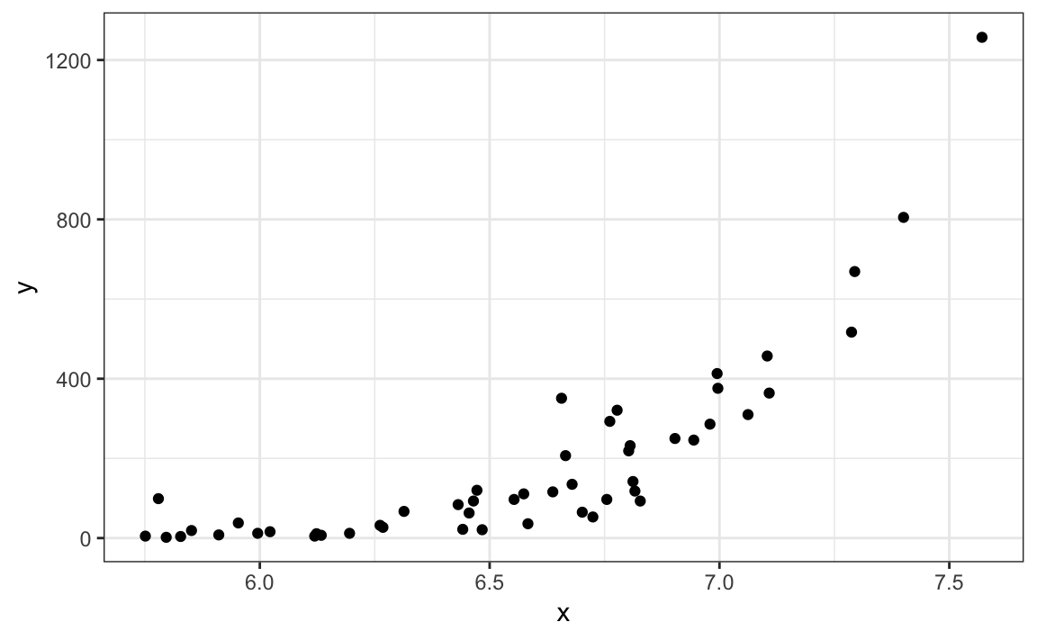
Quick plots with qplot
If we have values in two vectors, say:
data(murders)
x <- log10(murders$population)
y <- murders$total
and we want to make a scatterplot with ggplot, we would have to type something like:
data.frame(x = x, y = y) %>% ggplot(aes(x, y)) + geom_point()
This seems like too much code for such a simple plot. The qplot function sacrifices the flexibility provided by the ggplot approach, but allows us to generate a plot quickly.
qplot(x, y)
Notes:
We have learned the powerful approach to generating visualization with ggplot. However, there are instances in which all we want is to make a quick plot of, for example, a histogram of the values in a vector, a scatter plot of the values in two vectors, or a boxplot using categorical and numeric vectors. We demonstrated how to generate these plots with hist, plot, and boxplot. However, if we want to keep consistent with the ggplot style, we can use the function qplot.

Slide 22
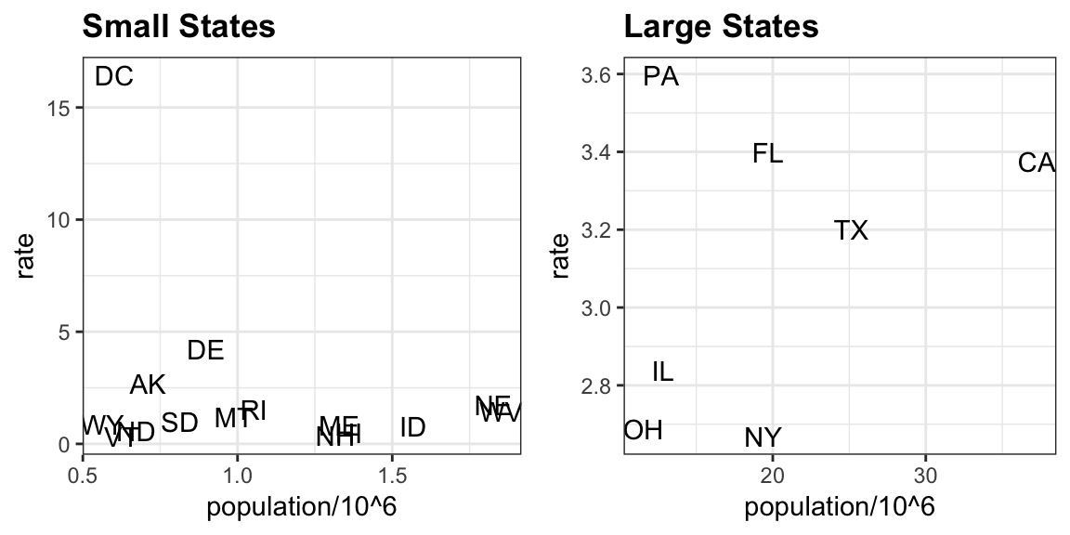
Grids of plots
library(gridExtra)
#> Attaching package: 'gridExtra’
#> The following object is masked from 'package:dplyr’:
#> combine
p1 <- murders %>% mutate(rate = total/population*10^5) %>%
filter(population < 2*10^6) %>%
ggplot(aes(population/10^6, rate, label = abb))
+ geom_text()
+ ggtitle("Small States")
p2 <- murders %>% mutate(rate = total/population*10^5) %>%
filter(population > 10*10^6) %>%
ggplot(aes(population/10^6, rate, label = abb)) +
geom_text() +
ggtitle("Large States")
grid.arrange(p1, p2, ncol = 2)

Slide 23
Other Geometries
Barplots
geom_bar
geom_col
Stripcharts
geom_jitter
Distribution Summaries
geom_histogram
geom_density
geom_violin
geom_boxplot

Slide 24
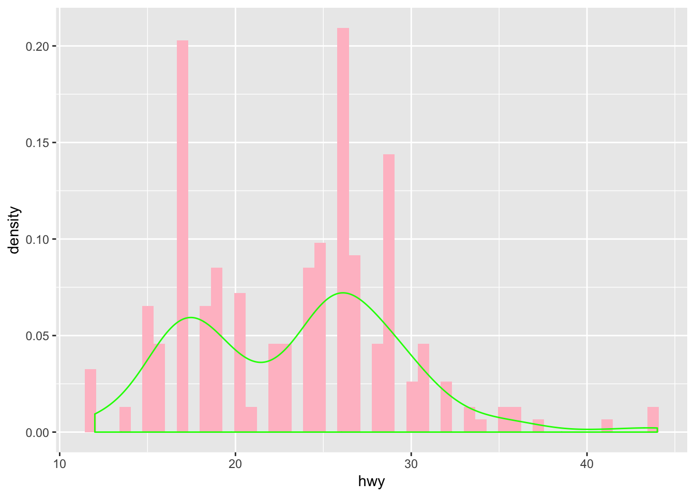
Histograms
ggplot(data = mpg) + geom_histogram(aes(x = hwy, y = ..density..), bins=50, fill = 'pink') + geom_density(aes(x = hwy),col = 'green')

Slide 25
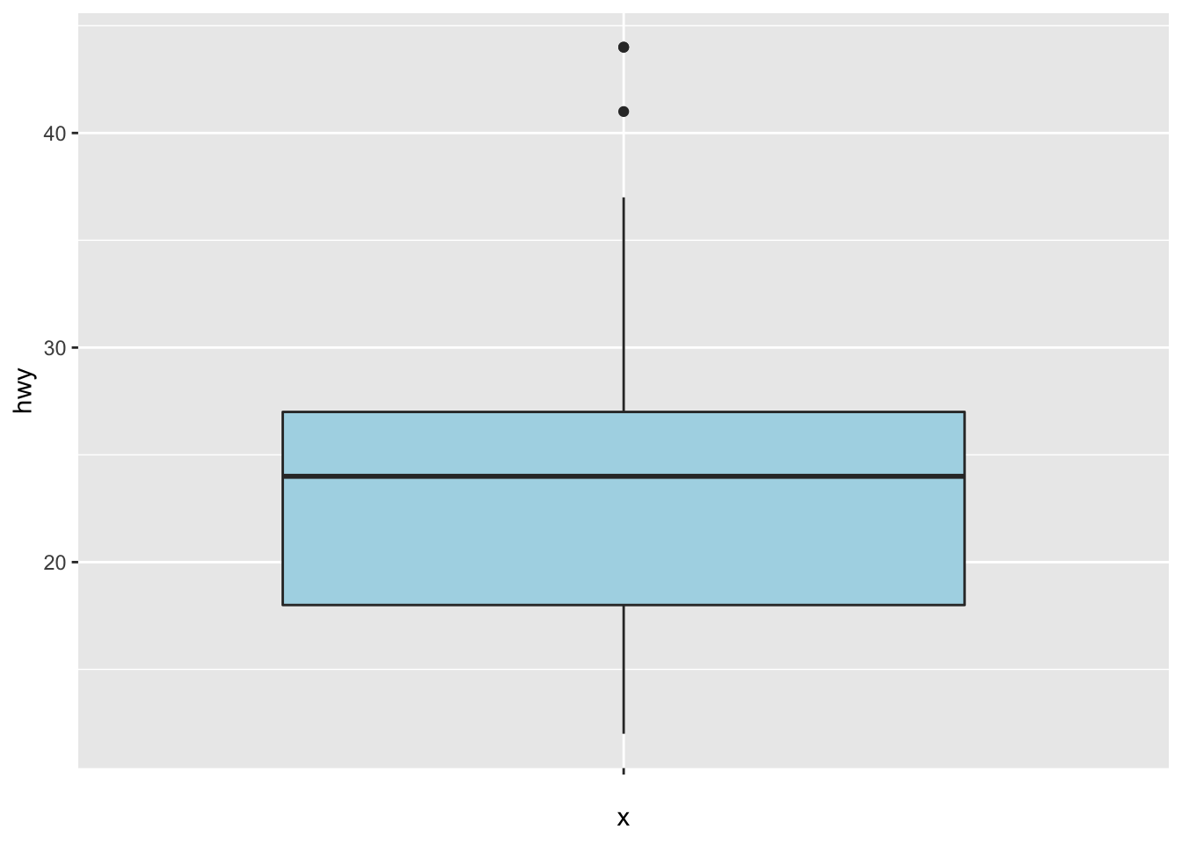
Boxplots
ggplot(data = mpg) + geom_boxplot(aes(x = '',y = hwy), fill = 'lightblue')

Slide 26
Let’s practice on boxplots
library(dplyr)
library(ggplot2)
# Step 1: Import the data
data_air <- airquality % > %
#Step 2: Drop unnecessary variables
select(-c(Solar.R, Temp)) % > %
#Step 3: Convert Month in factor level
mutate(Month = factor(Month, order = TRUE, labels = c("May", "June", "July", "August", "September")),
#Step 4: Create a new categorical variable dividing the month with three level: begin, middle and end.
day_cat = factor(ifelse(Day < 10, "Begin", ifelse(Day < 20, "Middle", "End"))))
glimpse(data_air)
# Step 5: Remove missing observations
data_air_nona <-data_air %>% na.omit()
## Observations: 153
## Variables: 5
## $ Ozone <int> 41, 36, 12, 18, NA, 28, 23, 19, 8, NA, 7, 16, 11, 14, ...
## $ Wind <dbl> 7.4, 8.0, 12.6, 11.5, 14.3, 14.9, 8.6, 13.8, 20.1, 8.6...
## $ Month <ord> May, May, May, May, May, May, May, May, May, May, May,...
## $ Day <int> 1, 2, 3, 4, 5, 6, 7, 8, 9, 10, 11, 12, 13, 14, 15, 16,...
## $ day_cat <fctr> Begin, Begin, Begin, Begin, Begin, Begin, Begin, Begi...

Slide 27
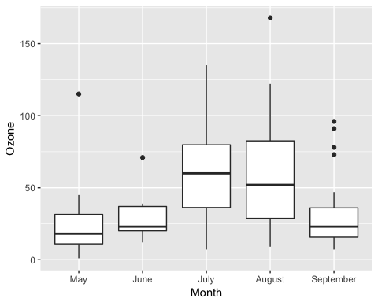
Basic box plot
Let’s plot the basic R boxplot() with the distribution of ozone by month.
# Store the graph
box_plot <- ggplot(data_air_nona, aes(x = Month, y = Ozone))
# Add the geometric object box
plot box_plot + geom_boxplot()
Code Explanation
Store the graph for further use
box_plot: You store the graph into the variable box_plot It is helpful for further use or avoid too complex line of codes
Add the geometric object of R boxplot()
You pass the dataset data_air_nona to ggplot boxplot.
Inside the aes() argument, you add the x-axis and y-axis.
The + sign means you want R to keep reading the code. It makes the code more readable by breaking it.
Use geom_boxplot() to create a box plot

Slide 28
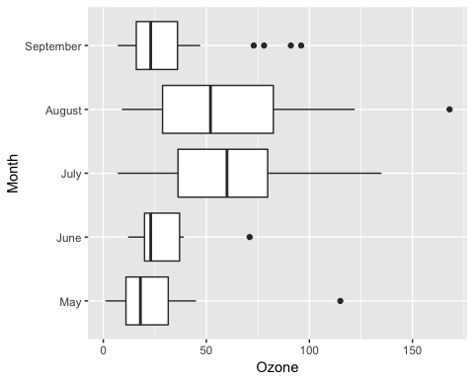
Change side of the graph
box_plot + geom_boxplot()+ coord_flip()
Code Explanation
box_plot: You use the graph you stored. It avoids rewriting all the codes each time you add new information to the graph.
geom_boxplot(): Create boxplots() in R
coord_flip(): Flip the side of the graph

Slide 29
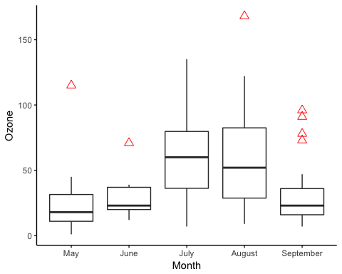
Change colour of outlier
box_plot + geom_boxplot(outlier.colour = "red", outlier.shape = 2, outlier.size = 3) + theme_classic()
Code Explanation
outlier.colour=”red”: Control the color of the outliers
outlier.shape=2: Change the shape of the outlier. 2 refers to triangle
outlier.size=3: Change the size of the triangle. The size is proportional to the number.

Slide 30
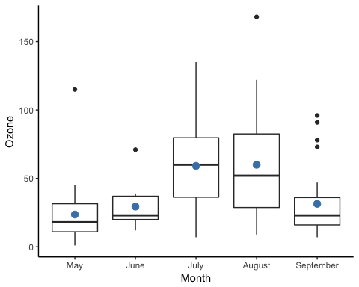
Add a summary statistic
box_plot + geom_boxplot() + stat_summary(fun.y = mean, geom = "point", size = 3, color = "steelblue") + theme_classic()
Code Explanation
stat_summary() allows adding a summary to the horizontal boxplot R
The argument fun.y controls the statistics returned. You will use mean
Note: Other statistics are available such as min and max. More than one statistics can be exhibited in the same graph
geom = “point”: Plot the average with a point
size=3: Size of the point
color =”steelblue”: Color of the points

Slide 31
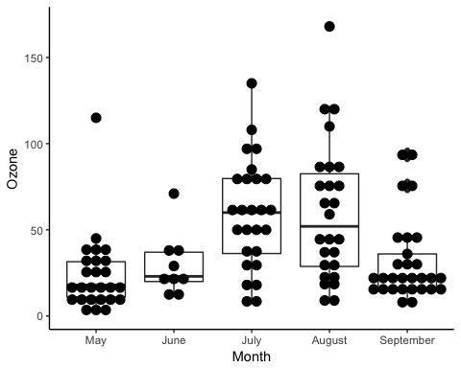
Box Plot with Dots
box_plot + geom_boxplot() + geom_dotplot(binaxis = 'y', dotsize = 1, stackdir = 'center') + theme_classic()
Code Explanation
geom_dotplot() allows adding dot to the bin width
binaxis=’y’: Change the position of the dots along the y-axis. By default, x-axis
dotsize=1: Size of the dots
stackdir=’center’: Way to stack the dots: Four values:
“up” (default),
“down”
“center”
“centerwhole”

Slide 32
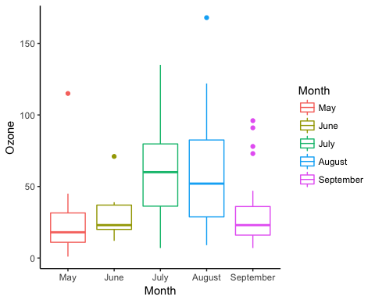
Change the color of the box
ggplot(data_air_nona, aes(x = Month, y = Ozone, color = Month)) + geom_boxplot() + theme_classic()
Code Explanation
The colors of the groups are controlled in the aes() mapping. You can use color= Month to change the color of the box and whisker plot according to the months

Slide 33
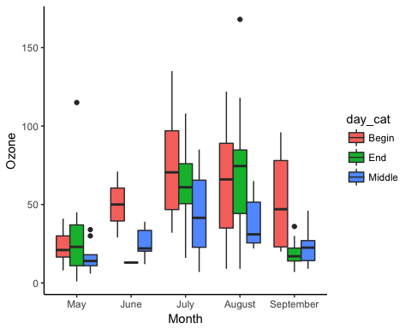
Box plot with multiple groups
ggplot(data_air_nona, aes(Month, Ozone)) + geom_boxplot(aes(fill = day_cat)) + theme_classic()
Code Explanation
The aes() mapping of the geometric object controls the groups to display (this variable has to be a factor)
aes(fill= day_cat) allows creating three boxes for each month in the x-axis

Slide 34
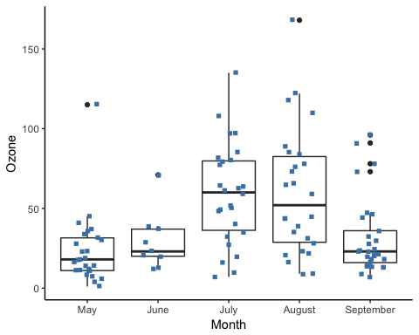
Box Plot with Jittered Dots
box_plot + geom_boxplot() + geom_jitter(shape = 15, color = "steelblue", position = position_jitter(width = 0.21)) + theme_classic()
Code Explanation
geom_jitter() adds a little decay to each point.
shape=15 changes the shape of the points. 15 represents the squares
color = “steelblue”: Change the color of the point
position=position_jitter(width = 0.21): Way to place the overlapping points. position_jitter(width = 0.21) means you move the points by 20 percent from the x-axis. By default, 40 percent.

Slide 35

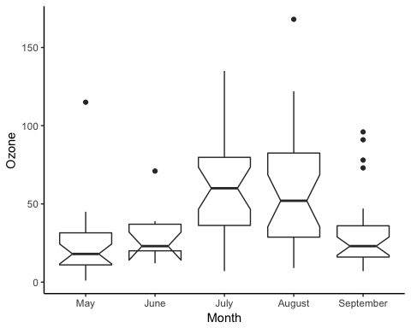
Notched Box Plot
An interesting feature of geom_boxplot(), is a notched boxplot function in R. The notch plot narrows the box around the median. The main purpose of a notched box plot is to compare the significance of the median between groups. There is strong evidence two groups have different medians when the notches do not overlap. A notch is computed as follow:
with is the interquartile and number of observations.
box_plot + geom_boxplot(notch = TRUE) + theme_classic()

Slide 36
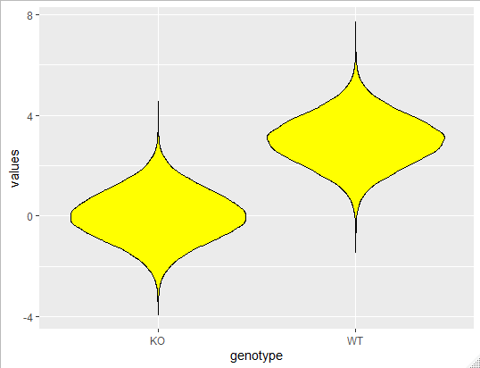
Plotting distributions – violin plots
> many.values
# A tibble: 100,000 x 2
values genotype
<dbl> <chr>
1 1.90 KO
2 2.39 WT
3 4.32 KO
4 2.94 KO
5 0.728 WT
6 -0.280 WT
7 0.337 WT
8 -1.31 WT
9 1.55 WT
10 1.86 KO
many.values %>%
ggplot(aes(x=genotype, y=values)) +
geom_violin(colour="black", fill="yellow")

Slide 37
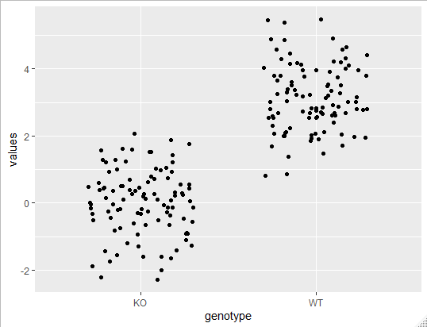
Plotting distributions – stripcharts
> many.values
# A tibble: 100,000 x 2
values genotype
<dbl> <chr>
1 1.90 KO
2 2.39 WT
3 4.32 KO
4 2.94 KO
5 0.728 WT
6 -0.280 WT
7 0.337 WT
8 -1.31 WT
9 1.55 WT
10 1.86 KO
many.values %>%
group_by(genotype) %>%
sample_n(100) %>%
ggplot(aes(x=genotype, y=values)) +
geom_jitter(height=0, width = 0.3)

Slide 38
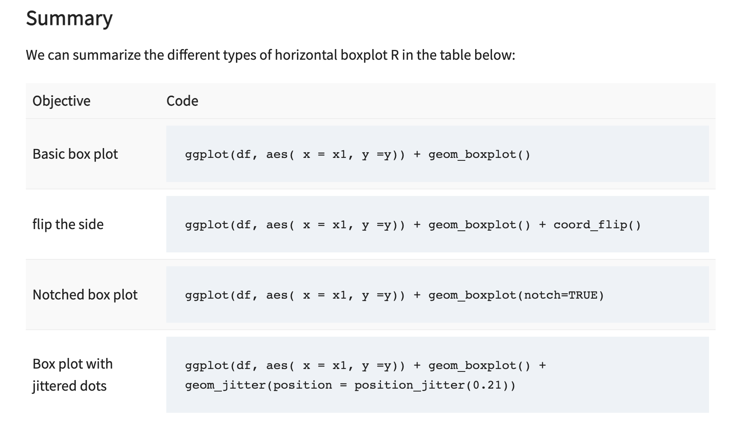
Summary

Slide 39

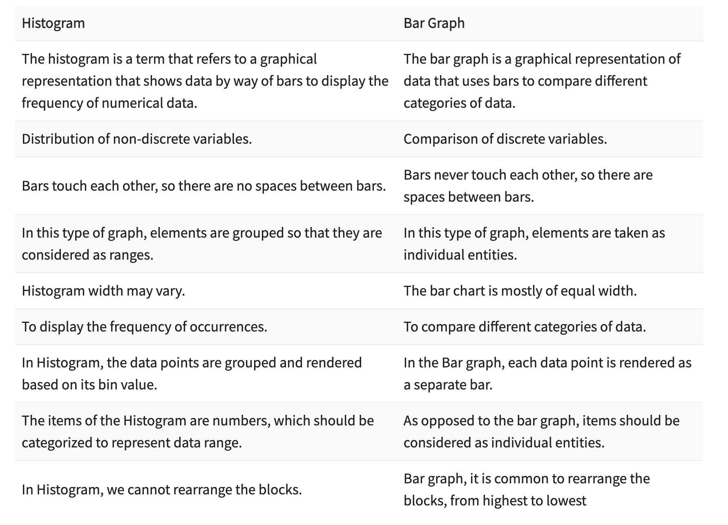
Barplots vs histograms

Slide 40
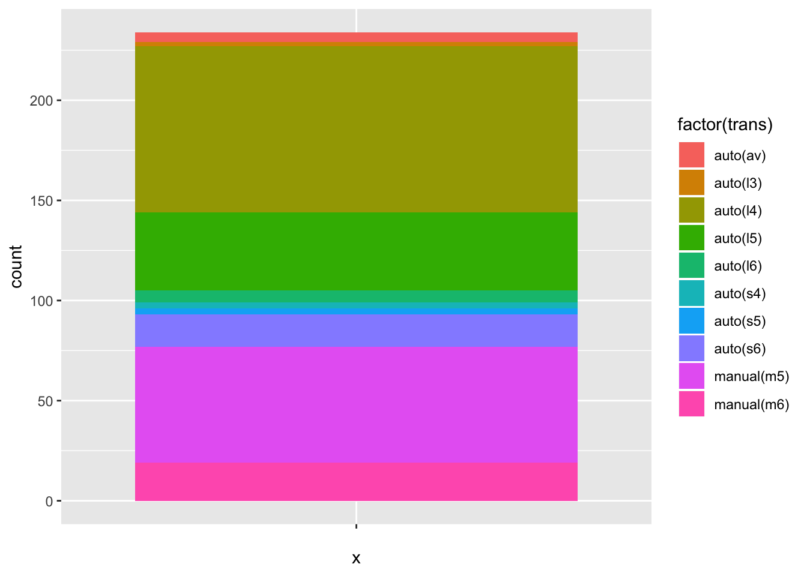
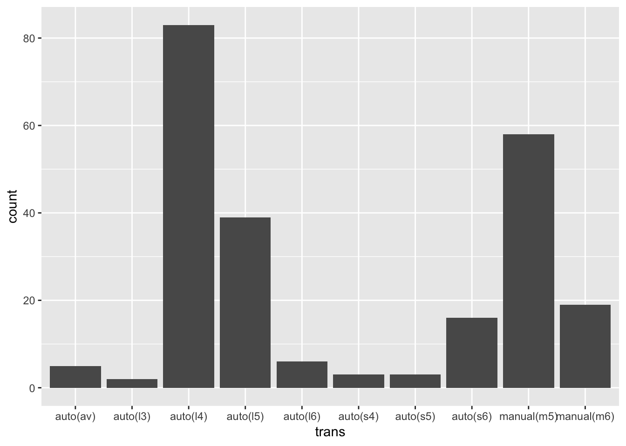
Barplots
ggplot(data = mpg) + geom_bar(aes(x = trans))
ggplot(data = mpg) + geom_bar(aes(x = "", fill = factor(trans)))

Slide 41
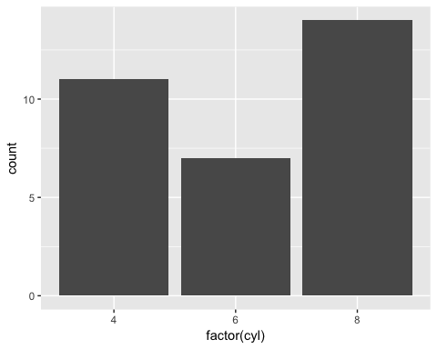
Bar chart: count
library(ggplot2)
# Most basic bar chart
ggplot(mtcars, aes(x = factor(cyl))) + geom_bar()
You pass the dataset mtcars to ggplot.
Inside the aes() argument, you add the x-axis as a factor variable(cyl)
The + sign means you want R to keep reading the code. It makes the code more readable by breaking it.
Use geom_bar() for the geometric object.

Slide 42
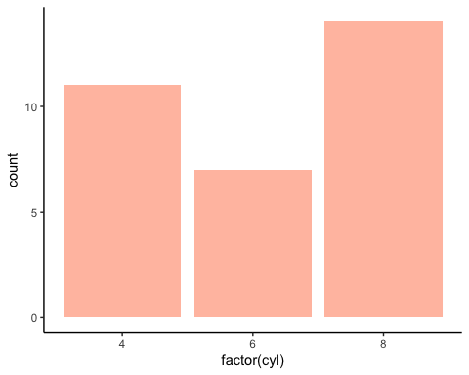
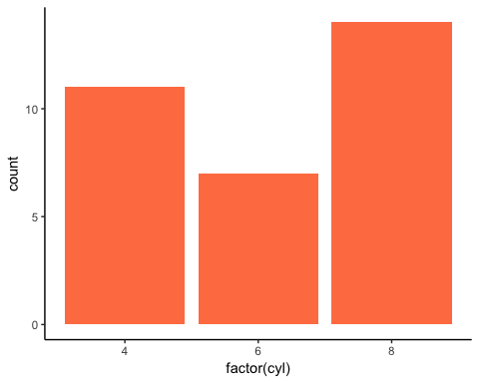
Change the color of the bars
# Change the color of the bars
ggplot(mtcars, aes(x = factor(cyl))) + geom_bar(fill = "coral") + theme_classic()
# Change intensity
ggplot(mtcars, aes(factor(cyl))) + geom_bar(fill = "coral", alpha = 0.5) + theme_classic()

Slide 43
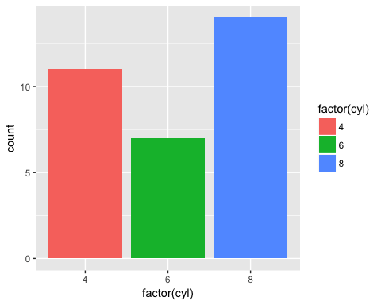
Color by groups
# Color by group
ggplot(mtcars, aes(factor(cyl), fill = factor(cyl))) + geom_bar()

Slide 44
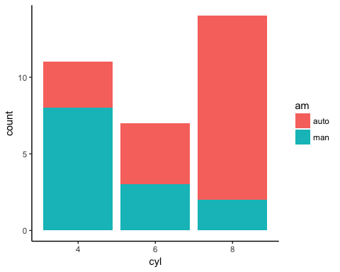
Add a group in the bars
You will proceed as follow:
Step 1: Create the data frame with mtcars dataset
Step 2: Label the am variable with auto for automatic transmission and man for manual transmission. Convert am and cyl as a factor so that you don’t need to use factor() in the ggplot() function.
Step 3: Plot the bar chart to count the number of transmission by cylinder
library(dplyr)
# Step 1
data <- mtcars % > %
#Step 2
mutate(am = factor(am, labels = c("auto", "man")), cyl = factor(cyl))
#Step 3
ggplot(data, aes(x = cyl, fill = am)) + geom_bar() + theme_classic()

Slide 45
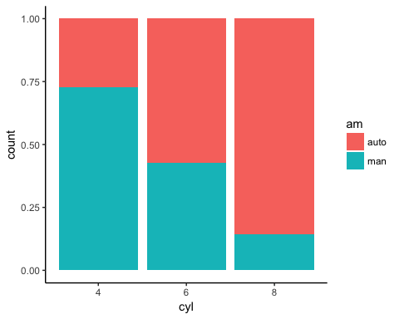
Bar chart in percentage
ggplot(data, aes(x = cyl, fill = am)) + geom_bar(position = "fill") + theme_classic()

Slide 46
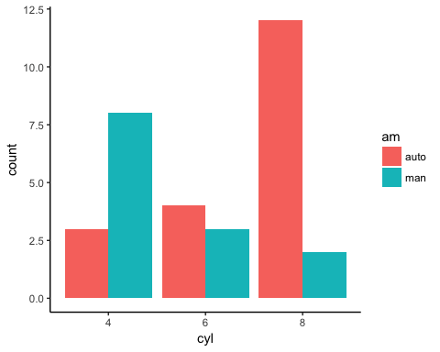
Side by side bars
# Bar chart side by side
ggplot(data, aes(x = cyl, fill = am)) + geom_bar(position = position_dodge()) + theme_classic()

Slide 47
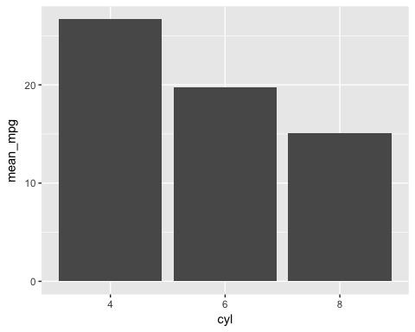
Bar plot
Your objective is to create a graph with the average mile per gallon for each type of cylinder.
Step 1: Create a new variable with the average mile per gallon by cylinder
Step 2: Create a basic bp
Step 3: Change the orientation
Step 4: Change the color
Step 5: Change the size
Step 6: Add labels to the graph
# Step 1
data_pb <- mtcars % > % mutate(cyl = factor(cyl)) % > % group_by(cyl) % > % summarize(mean_mpg = round(mean(mpg), 2))
# Step 2
ggplot(data_bp, aes(x = cyl, y = mean_mpg)) + geom_bar(stat = "identity")

Slide 48
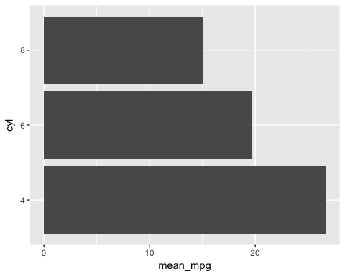
Bar plot
Step 3) Change the orientation
ggplot(data_histogram, aes(x = cyl, y = mean_mpg)) + geom_bar(stat = "identity") + coord_flip()

Slide 49
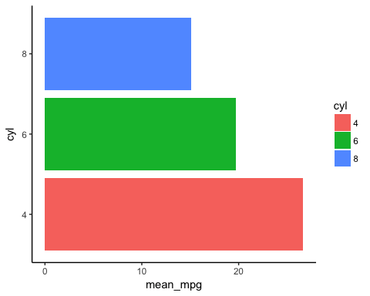
Bar plot
Step 4) Change the color
ggplot(data_bp, aes(x = cyl, y = mean_mpg, fill = cyl)) + geom_bar(stat = "identity") + coord_flip() + theme_classic()

Slide 50

Bar plot
Step 5) Change the size
graph <- ggplot(data_bp, aes(x = cyl, y = mean_mpg, fill = cyl)) + geom_bar(stat = "identity", width = 0.5) + coord_flip() + theme_classic()

Slide 51

Bar plot
Step 6) Add labels to the graph
graph + geom_text(aes(label = mean_mpg), hjust = 1.5, color = "white", size = 3) + theme_classic()

Slide 52
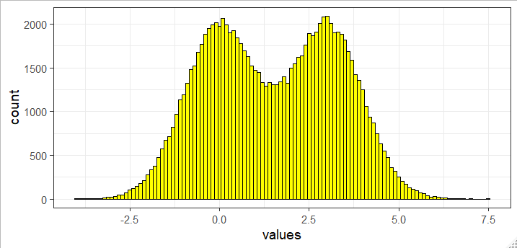
Plotting distributions - histograms
> many.values
# A tibble: 100,000 x 2
values genotype
<dbl> <chr>
1 1.90 KO
2 2.39 WT
3 4.32 KO
4 2.94 KO
5 0.728 WT
6 -0.280 WT
7 0.337 WT
8 -1.31 WT
9 1.55 WT
10 1.86 KO
many.values %>%
ggplot(aes(x=values)) +
geom_histogram(binwidth = 0.1, fill="yellow", colour="black")

Slide 53
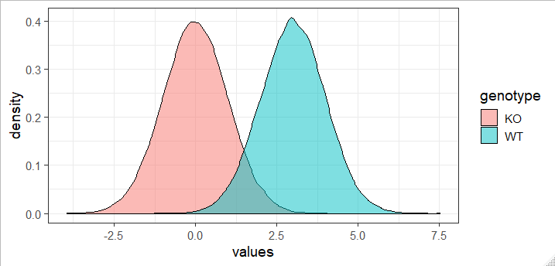
Plotting distributions - density
> many.values
# A tibble: 100,000 x 2
values genotype
<dbl> <chr>
1 1.90 KO
2 2.39 WT
3 4.32 KO
4 2.94 KO
5 0.728 WT
6 -0.280 WT
7 0.337 WT
8 -1.31 WT
9 1.55 WT
10 1.86 KO
many.values %>%
ggplot(aes(x=values, fill=genotype)) +
geom_density(colour="black", alpha=0.5)

Slide 54
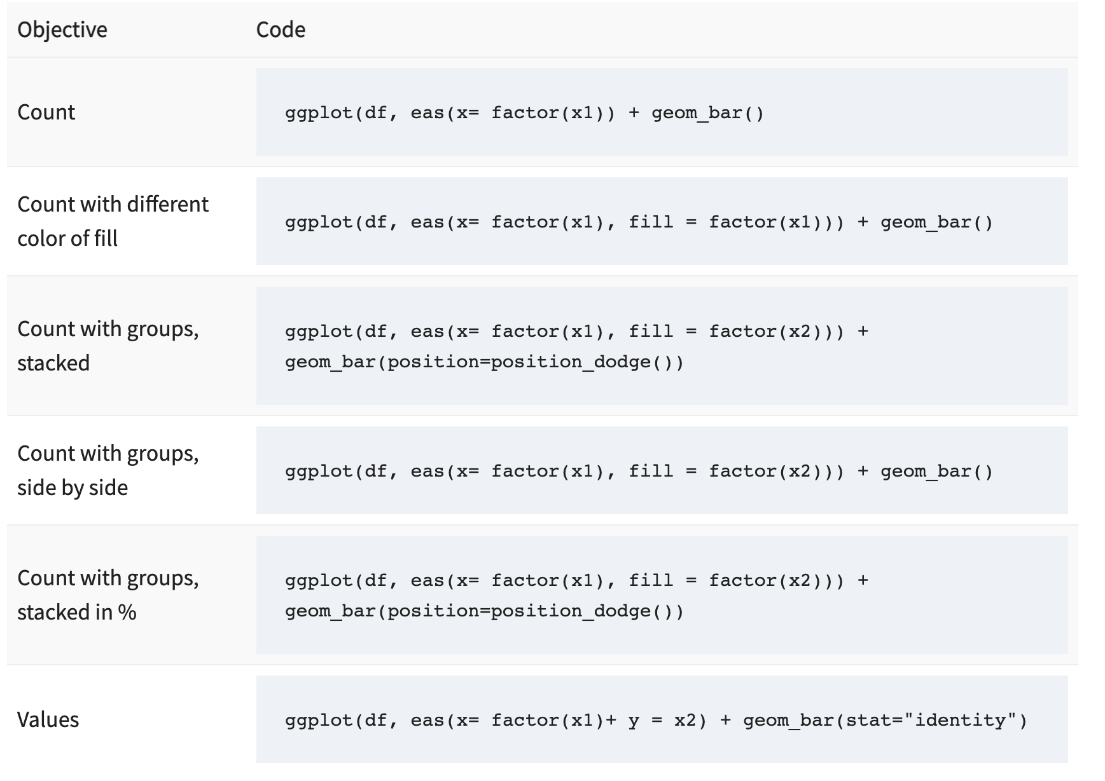
summary

Slide 55
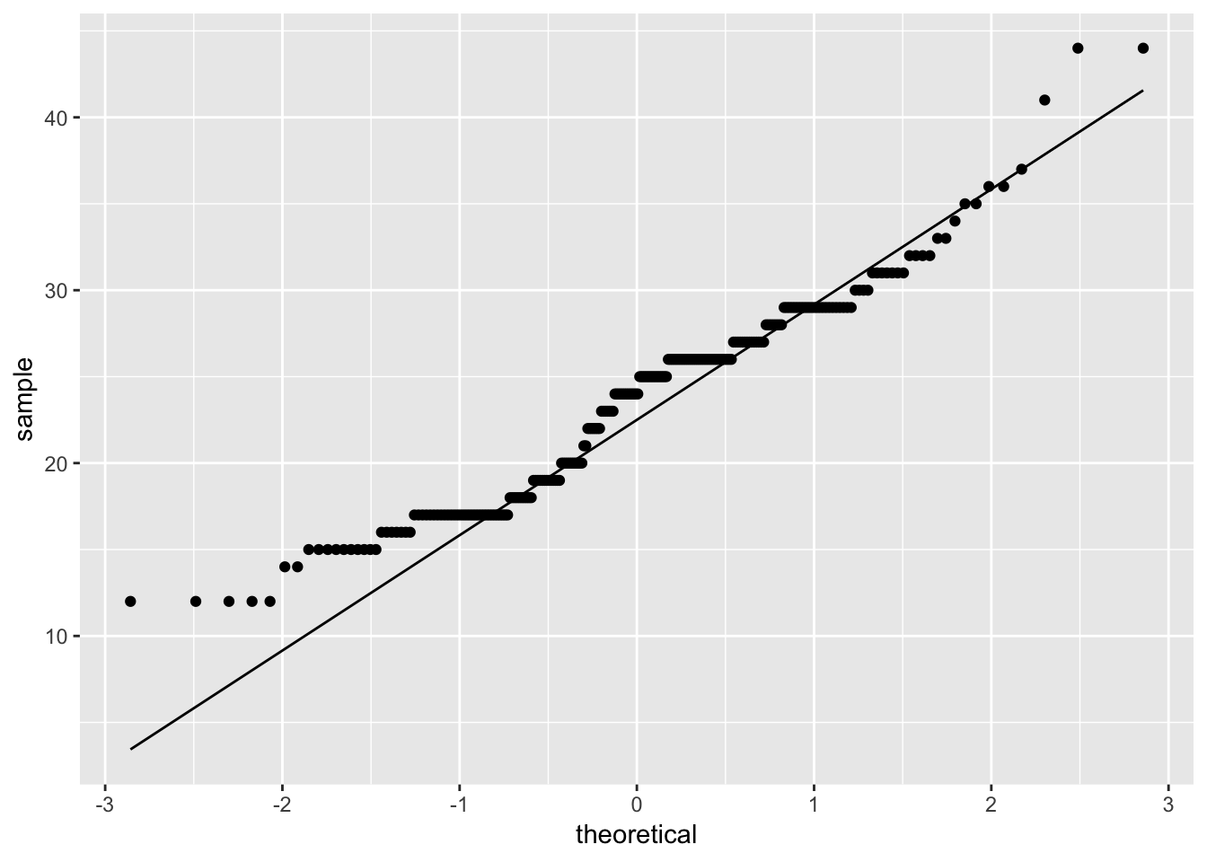
Compare distributions
ggplot(data = mpg) + geom_qq(aes(sample = hwy)) + geom_qq_line(aes(sample = hwy))

Slide 56
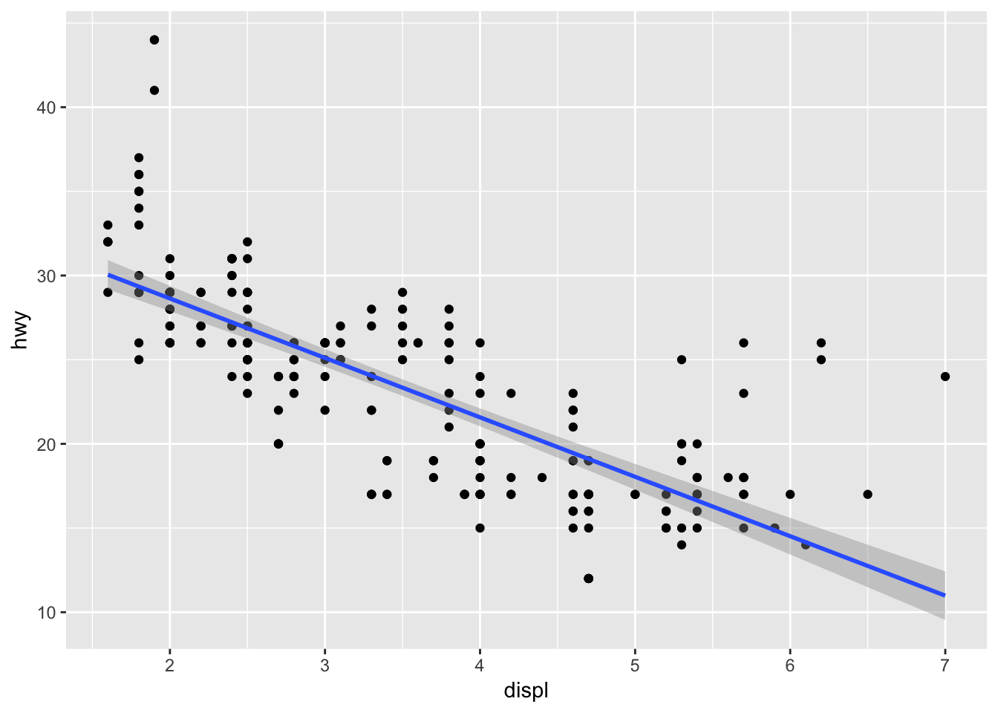
Linear model
gplot(data = mpg) + geom_point(mapping = aes(x = displ, y = hwy)) + geom_smooth(mapping = aes(x = displ, y = hwy),method = 'lm')

Slide 57
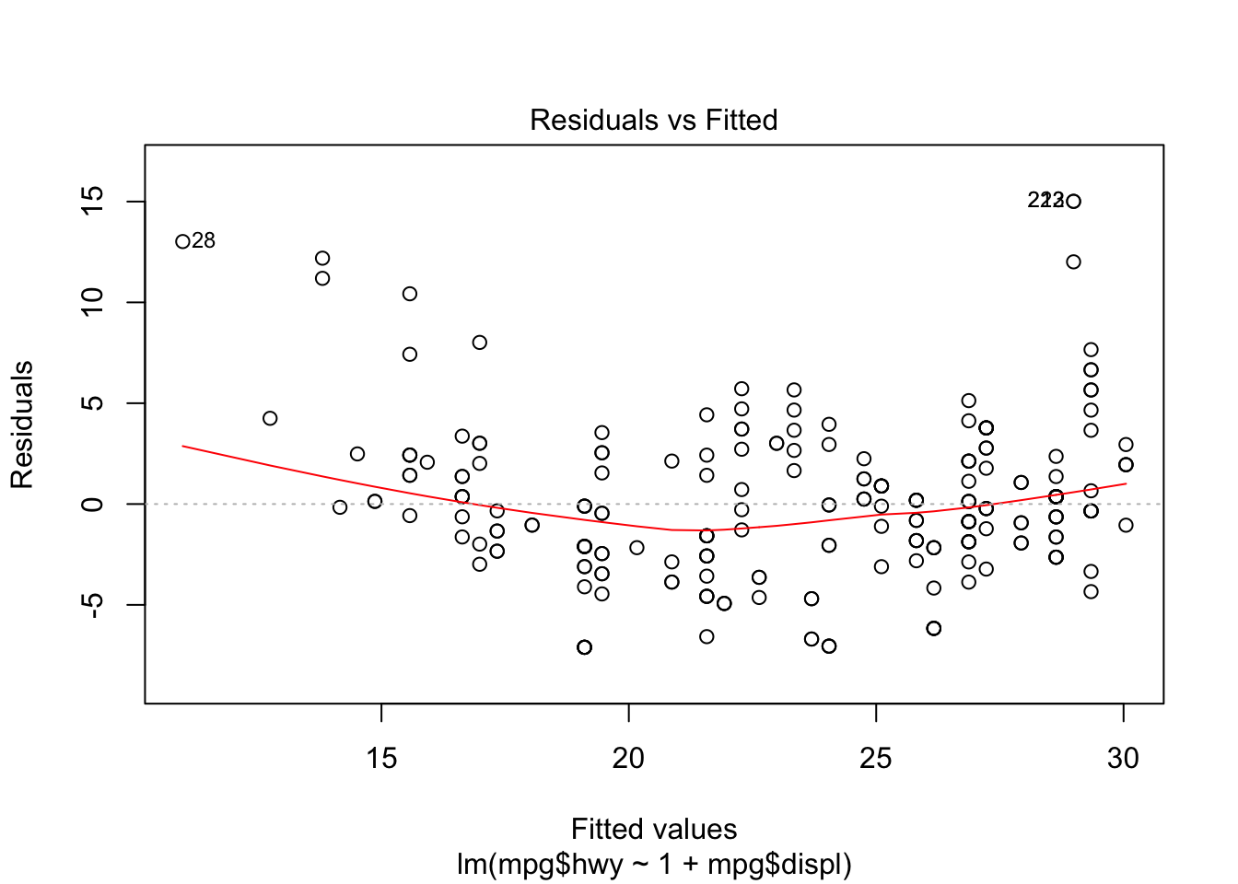
Linear model
out = lm(mpg$hwy ~ 1 + mpg$displ)
plot(out)

Slide 58
Titles and axis labels
Can add calls to functions to set them individually
ggtitle("Main title")
xlab("X axis")
ylab("Y axis")
Can set them all together with labs()
title="Main title"
x="X axis"
y="Y axis"

Slide 59
Changing scaling
Alter the data before plotting
mutate(value=log(value))
Alter the data whilst plotting
ggplot(aes(x=log(value)))
Alter the scale of the plot
Add an option to adjust the scaling of the axis

Slide 60
Axis scaling options
Transforming scales
scale_x_log10()
scale_x_sqrt()
scale_x_reverse()
Equivalent _y_ versions also exist
Switching axes
coord_flip()
Adjusting ranges
scale_x_continuous()
limits=c(-5,5)
breaks=seq(from=-5,by=2,to=5)
minor_breaks
labels
coord_cartesian()
xlim=c(-5,5)
ylim=c(10,20)

Slide 61
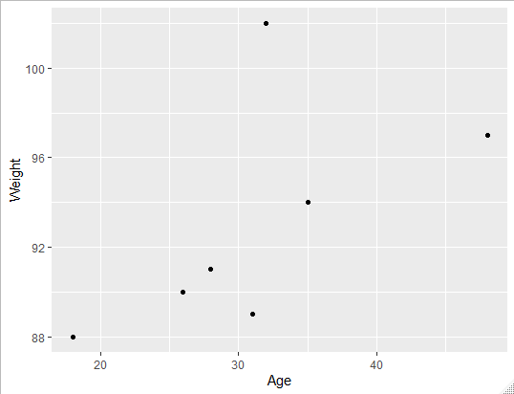
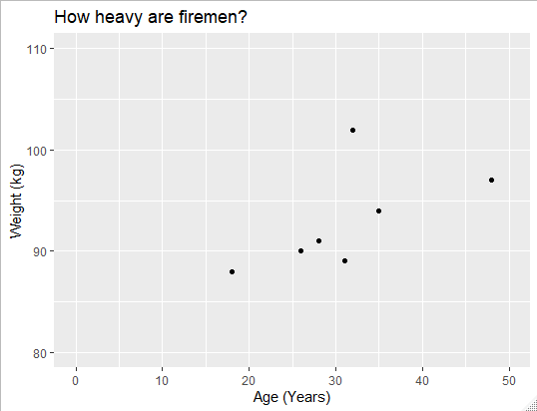
Annotation and scaling example
trumpton %>%
ggplot(aes(x=Age, y=Weight))+
geom_point() +
xlab("Age (Years)")+
ylab("Weight (kg)")+
ggtitle("How heavy are firemen?")+
coord_cartesian(
xlim=c(0,50),
ylim=c(80,110)
)

Slide 62
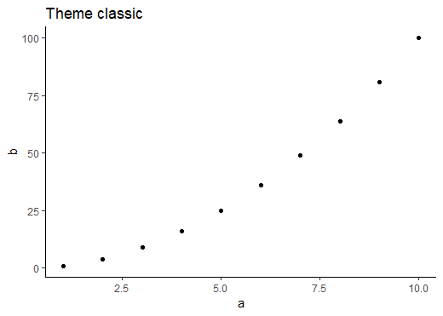
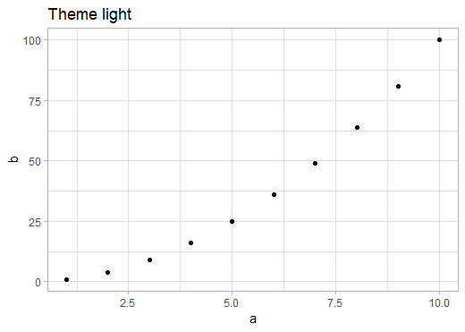





ggPlot Themes
theme_grey()
theme_bw()
theme_dark()
theme_light()
theme_minimal()
theme_classic()
theme_linedraw()

Slide 63
Setting and Customising themes
Globally
theme_set(theme_bw(base_size=14))
In a single plot
+theme_dark()

Slide 64
Customising themes
theme_update(plot.title = element_text(hjust = 0.5))
plot + theme(plot.title = element_text(hjust = 0.5))
theme(line, rect, text, title, aspect.ratio, axis.title, axis.title.x, axis.title.x.top, axis.title.x.bottom, axis.title.y, axis.title.y.left,axis.title.y.right, axis.text, axis.text.x, axis.text.x.top, axis.text.x.bottom, axis.text.y, axis.text.y.left, axis.text.y.right, axis.ticks, axis.ticks.x, axis.ticks.x.top, axis.ticks.x.bottom, axis.ticks.y, axis.ticks.y.left, axis.ticks.y.right, axis.ticks.length, axis.line, axis.line.x, axis.line.x.top, axis.line.x.bottom, axis.line.y, axis.line.y.left, axis.line.y.right, legend.background, legend.margin, legend.spacing, legend.spacing.x, legend.spacing.y, legend.key, legend.key.size, legend.key.height, legend.key.width, legend.text, legend.text.align, legend.title, legend.title.align, legend.position, legend.direction, legend.justification, legend.box, legend.box.just, legend.box.margin, legend.box.background, legend.box.spacing, panel.background, panel.border, panel.spacing, panel.spacing.x, panel.spacing.y, panel.grid, panel.grid.major, panel.grid.minor, panel.grid.major.x, panel.grid.major.y, panel.grid.minor.x, panel.grid.minor.y, panel.ontop, plot.background, plot.title, plot.subtitle, plot.caption, plot.tag, plot.tag.position, plot.margin, strip.background, strip.background.x, strip.background.y, strip.placement, strip.text, strip.text.x, strip.text.y, strip.switch.pad.grid, strip.switch.pad.wrap)
https://ggplot2.tidyverse.org/reference/theme.html

Slide 65

Theme setting example
theme_set(theme_bw(base_size = 14))
theme_update(plot.title = element_text(hjust=1))
OR
my.plot +
theme_bw(base_size = 14) +
theme(plot.title = element_text(hjust=1))

Slide 66

Changing Quantitative Colours
storms %>%
ggplot(aes(x=lat, y=long, colour=wind)) +
geom_point()

Slide 67


Changing Plotting Order
storms %>%
ggplot(aes(x=lat,y=long,colour=wind))+
geom_point()
storms %>%
arrange(wind) %>%
ggplot(aes(x=lat,y=long,colour=wind))+
geom_point()

Slide 68

Changing Quantitative Colours
storms %>%
arrange(wind) %>%
ggplot(aes(x=lat, y=long, colour=wind))+
geom_point() +
scale_colour_gradient(low="lightgrey", high="blue")

Slide 69

Changing Quantitative Colours
storms %>%
arrange(wind) %>%
ggplot(aes(x=lat, y=long, colour=wind))+
geom_point() +
scale_colour_gradientn(colours=c("blue","green2","red","yellow"))

Slide 70

ColorBrewer Scales
Quantitative
scale_colour_distiller
Categorical
scale_colour_brewer

Slide 71

Changing Quantitative Colours
storms %>%
arrange(wind) %>%
ggplot(aes(x=lat, y=long, color=wind))+
geom_point() +
scale_color_distiller(palette="Reds", direction = 1)

Slide 72

Changing Categorical Colours
storms %>%
filter(year==1983) %>%
ggplot(aes(x=wind, y=pressure, colour=status)) +
geom_point(size=3)

Slide 73

Changing Categorical Colours
storms %>%
filter(year==1983) %>%
ggplot(aes(x=wind,y=pressure, colour=status)) +
geom_point(size=3) +
scale_colour_manual(values = c("orange","purple","green2"))

Slide 74

Changing Categorical Colours
storms %>%
filter(year==1983) %>%
ggplot(aes(x=wind,y=pressure, colour=status)) +
geom_point(size=3) +
scale_colour_brewer(palette="Set1")

Slide 75
Categorical Colour Ordering
# A tibble: 10,010 x 6
lat long status category wind pressure
<dbl> <dbl> <chr> <ord> <int> <int>
1 27.5 -79 tropical depression -1 25 1013
2 28.5 -79 tropical depression -1 25 1013
3 29.5 -79 tropical depression -1 25 1013
4 30.5 -79 tropical depression -1 25 1013
5 31.5 -78.8 tropical depression -1 25 1012
6 32.4 -78.7 tropical depression -1 25 1012
7 33.3 -78 tropical depression -1 25 1011
8 34 -77 tropical depression -1 30 1006
9 34.4 -75.8 tropical storm 0 35 1004
10 34 -74.8 tropical storm 0 40 1002
# ... with 10,000 more rows
Status is a character vector – ordering is alphabetical

Slide 76
Factors
Similar to text (character) vectors, but with some differences
They have controlled values – you can limit which values can be added
The values which can go in are tracked separately to the data
The values which can go in have an explicit order
GGplot respects the ordering of factors, so converting to factors is the simplest way to re-order a plot

Slide 77
Converting character vectors to factors
> chr.names
[1] "simon" "anne" "laura" "felix" "simon" "anne" "laura"
[8] "felix" "simon" "anne" "laura" "felix" "simon" "anne"
[15] "laura" "felix" "simon" "anne" "laura" "felix"
> factor(chr.names)
[1] simon anne laura felix simon anne laura felix simon
[10] anne laura felix simon anne laura felix simon anne
[19] laura felix
Levels: anne felix laura simon
> factor(chr.names, levels=c("simon","anne","laura","felix"))
[1] simon anne laura felix simon anne laura felix simon
[10] anne laura felix simon anne laura felix simon anne
[19] laura felix
Levels: simon anne laura felix

Slide 78
Categorical Colour Ordering
Use factors for explicit ordering
storms %>%
mutate(
status=factor(
status,
levels=c("tropical depression","tropical storm","hurricane")
)
)
# A tibble: 10,010 x 6
lat long status category wind pressure
<dbl> <dbl> <fct> <ord> <int> <int>
1 27.5 -79 tropical depression -1 25 1013
2 28.5 -79 tropical depression -1 25 1013
3 29.5 -79 tropical depression -1 25 1013
4 30.5 -79 tropical depression -1 25 1013

Slide 79

Categorical Colour Ordering
storms %>%
mutate(status=factor(status, levels=c("tropical depression","tropical storm","hurricane"))) %>%
filter(year==1983) %>%
ggplot(aes(x=wind,y=pressure, colour=status)) +
geom_point(size=3)+
scale_color_brewer(palette="Set1")

Slide 80

Reordering example Keep the original order
LastName FirstName Age Weight Height
<chr> <chr> <dbl> <dbl> <dbl>
1 Hugh Chris 26 90 175
2 Pew Adam 32 102 183
3 Barney Daniel 18 88 168
4 McGrew Chris 48 97 155
5 Cuthbert Carl 28 91 188
6 Dibble Liam 35 94 145
7 Grub Doug 31 89 164
trumpton %>%
ggplot(aes(x=LastName, y=Height)) +
geom_col()
The default is to order alphabetically

Slide 81

Reordering example Keep the original order
LastName FirstName Age Weight Height
<chr> <chr> <dbl> <dbl> <dbl>
1 Hugh Chris 26 90 175
2 Pew Adam 32 102 183
3 Barney Daniel 18 88 168
4 McGrew Chris 48 97 155
5 Cuthbert Carl 28 91 188
6 Dibble Liam 35 94 145
7 Grub Doug 31 89 164
trumpton %>%
mutate(LastName=factor(LastName, levels=LastName)) %>%
ggplot(aes(x=LastName, y=Height)) +
geom_col()
We can convert to a factor and use levels to enforce the same order. If we had just converted to a factor it would have been alphabetical still.

Slide 82
Quantitative ordering with reorder
The reorder function allows you to order the levels of a factor by a different quantitative variable
It allows you to sort a figure by value
reorder(categorical, quantitative)

Slide 83

Reordering examples
LastName FirstName Age Weight Height
<chr> <chr> <dbl> <dbl> <dbl>
1 Hugh Chris 26 90 175
2 Pew Adam 32 102 183
3 Barney Daniel 18 88 168
4 McGrew Chris 48 97 155
5 Cuthbert Carl 28 91 188
6 Dibble Liam 35 94 145
7 Grub Doug 31 89 164
trumpton %>%
mutate(LastName=reorder(LastName,Height)) %>%
ggplot(aes(x=LastName, y=Height)) +
geom_col()
By using reorder we can make the levels correspond to a quantitative variable. Here it is the same one we're plotting, but it doesn't have to be.

Slide 84

Reordering examples
LastName FirstName Age Weight Height
<chr> <chr> <dbl> <dbl> <dbl>
1 Hugh Chris 26 90 175
2 Pew Adam 32 102 183
3 Barney Daniel 18 88 168
4 McGrew Chris 48 97 155
5 Cuthbert Carl 28 91 188
6 Dibble Liam 35 94 145
7 Grub Doug 31 89 164
trumpton %>%
mutate(LastName=reorder(LastName,-Height)) %>%
ggplot(aes(x=LastName, y=Height)) +
geom_col()
We can use -Height in the reorder to reverse the sorting order

Slide 85
Exercise 1: Simple point and line plots
Load the data from the weight_chart.txt file. This is a tab delimited text file. You’ll need to use library(tidyverse) to load the tidyverse functions, then set the working directory with Session > Set Working Directory > Choose Directory in RStudio then use read_delim() to load the file and save it to a variable.
This file contains the details of the growth of a baby over the first few months of its life.
Draw a scatterplot (using geom_point) of the Age vs Weight. When defining your aesthetics the Age will be the x and Weight will be the y.
Make all of the points filled with blue2 by putting a fixed aesthetic into geom_point() and give them a size of 3
You will see that an obvious relationship exists between the two variables. Change the geometry to geom_line to see another way to represent this plot.
Combine the two plots by adding both a geom_line and a geom_point geometry to show both the individual points and the overall trend.

Slide 86


Exercise 2 Fancy the iris dot-plot.
Exercise 3 Faceted smoothing (iris, once again).

Slide 87


Exercise 4 mtcars bubble-plot.
Exercise 5 Polar barplot of the mean diamond price per cut and color.

Slide 88

Exercise 6 Economist style economics time series. (Hint: you will need the ggthemes package.)

Slide 89
Exercise 7 Load the ggplot2, MASS and viridis packages. Combine the three Pima data-sets from (MASS) and make a 2D density (density heat map) plot of bp versus bmi using scale_fill_viridis().
Exercise 8
Using the same data, overlay a histogram of bmi with a normal density curve using the sample mean and standard deviation.
Exercise 9
Using the accdeaths data-set from MASS, make a line plot with time on the x-axis. Mark the maximum and minimum value of accidental deaths in a month with a read and blue dot, respectively. Note that the data does not come in ggplot-friendly format.
Exercise 10 The internet surely loves cats, but most users have little idea how much a cat’s organs weigh. Using the cats data from the MASS package, make two 2D density plot of total weight versus hearth weight, side by side; one for each gender. In addition, add a dot for each observation.
Exercise 11 Back to the pima data. Make a boxplot for the glu (glucose concentration), splitting the observations into five age groups with approximately the same number of observations. Exercise 12 Using ggplot2‘s inbuilt economics data-set, make a stacked bar plot with proportions of unemployed to employed (employed or not seeking work) with the date in the x-axis.
Exercise 13 Using ggplot2‘s inbuilt msleep data-set, make a scatter plot (body weight versus total sleep) of all animals of the order artiodactyla. Mark the domesticated animals with a different color (from black) and annotate their names onto the graph.
Exercise 14 Using msleep, make one density plot for the total sleep, colored by vore. Play with the transparency and parameters of the density estimation.

